Slide 1
Parsing
SPECIAL TOPICS IN DATABASE
2012210047 Jong-Seon Kim
2015-04-07

Slide 2
Contents
18.1 Syntax vs Semantics
18.2 Lexical Analysis
18.3 Implementing the Lexical Analyzer
18.4 Grammars
18.5 Recursive-Descent Parsers
18.6 Adding Actions to the Parser

Slide 3
Contents
18.1 Syntax vs Semantics
18.2 Lexical Analysis
18.3 Implementing the Lexical Analyzer
18.4 Grammars
18.5 Recursive-Descent Parsers
18.6 Adding Actions to the Parser

Slide 4
18.1 Syntax vs Semantics
- SQL String is processed into scan
- Two Processes
  1. syntax-based -> parsing
  - 2. semantic-based -> planning (chapter 19)
Notes:
SQL String을 실행하기 위해 DB system은 scan으로 바꾸는데 바꾸는 과정은 syntax-based 과정인 parsing과 semantic-based 과정인 Planning이 있다.

Slide 5
18.1 Syntax vs Semantics
- SQL String is processed into scan
- Two Processes
  1. syntax-based -> parsing
  - 2. semantic-based -> planning (chapter 19)
Notes:
SQL String을 실행하기 위해 DB system은 scan으로 바꾸는데 바꾸는 과정은 syntax-based 과정인 parsing과 semantic-based 과정인 Planning이 있다.

Slide 6
Syntax vs Semantics (cont)
Def) Syntax
  A set of rules that describe strings.
Def) Semantics
  Actual meaning of a syntactically correct string.
Notes:
Syntax와 Semantics의 정의
Syntax는 결국 SQL String이 지켜야 할 구조적 규칙이고
Semantics은 이런 syntax가 지켜진 String의 의미를 의미한다

Slide 7
Syntax vs Semantics (cont)
Example of syntactically illegal
- Select from tables T1 and T2 where b – 3
Example of syntactically legal
- Select a from x, z where b = 3
Notes:
Syntactically 맞는 sql과 맞지 않는 sql의 예시
위에 예시는 4가지 문제점을 가지고 있음
Select 다음에는 필드명이 와야 하며 tables는 키워드가 아니고 table을 나열할때는 and대신 comma를 사용 b - 3은 predicate가 아님

Slide 8
Contents
18.1 Syntax vs Semantics
18.2 Lexical Analysis
18.3 Implementing the Lexical Analyzer
18.4 Grammars
18.5 Recursive-Descent Parsers
18.6 Adding Actions to the Parser

Slide 9
18.2 Lexical Analysis
Lexical Analysis
- Split SQL string into many tokens.
- Lexical Analyzer’ s job.
What is Token?
- Token has type and value
Notes:
Parser가 가장 먼저 하는 일은 Lexical Analysis다
Parser의 Lexical Analyzer가 이 작업을 함
Lexical Analysis는 Input String을 여러 개의 token으로 만드는 작업

Slide 10
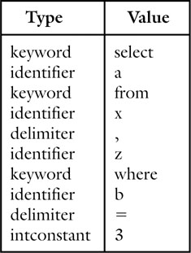
Lexical Analysis (cont)
Input String : select a from x, z where b = 3
Notes:
Lexical Analyzer에 다음과 같은 Input String을 넣으면 다음과 같은 output을 만들어 낸다.

Slide 11
Lexical Analysis (cont)
Token’s Five Type
1. Delimiters
- ‘=’ or ‘ , ’ (one - character)
2. Integer Constants
- 123, 234, 40
3. String Constants
- ‘computer’, ‘abc’
4. Keywords
- select, from, where, insert etc.
5. Identifiers
- DeptID, SName etc.
Notes:
Token은 5가지 type이 있다.
Delimiter는 some kinds of division character
Integer와 String Constants는 각각 int형, string형 문자열을 나타냄
Keyword에는 String중에서도 SQL에서 reserved string
Identifiers는 Table의 Column명이나 Table명을 지칭하는 String

Slide 12
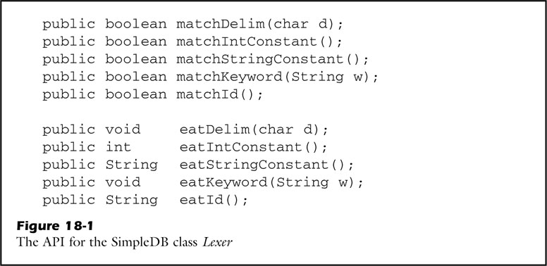
Lexical Analysis (cont)
Lexer(Lexical Analyzer) API
Notes:
Lexer의 API

Slide 13
Contents
18.1 Syntax vs Semantics
18.2 Lexical Analysis
18.3 Implementing the Lexical Analyzer
18.4 Grammars
18.5 Recursive-Descent Parsers
18.6 Adding Actions to the Parser

Slide 14

18.3 Implementing the Lexical Analyzer
Class Lexer Variables
- keywords : Reserved Strings( ex) select, from, where )
- tok : Use StreamTokenizer to support 5 types of tokens

Slide 15
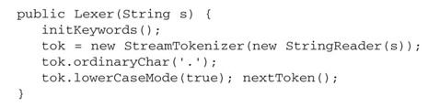
Implementing the Lexical Analyzer (cont)
Class Lexer Constructor
- String s : Input SQL string
- initkeywords() : Initializing all keywords to variable keywords

Slide 16
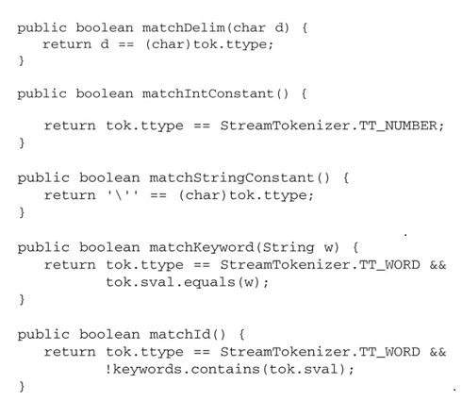
Implementing the Lexical Analyzer (cont)
Class Lexer Methods

Slide 17
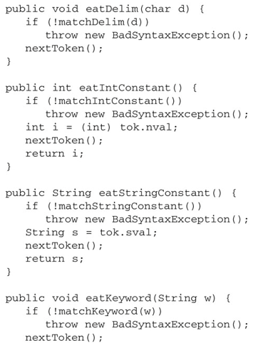
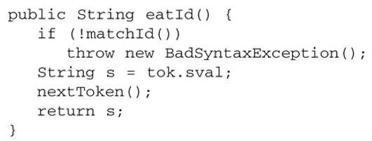
Implementing the Lexical Analyzer (cont)
Class Lexer Methods

Slide 18
Contents
18.1 Syntax vs Semantics
18.2 Lexical Analysis
18.3 Implementing the Lexical Analyzer
18.4 Grammars
18.5 Recursive-Descent Parsers
18.6 Adding Actions to the Parser

Slide 19
18.4 Grammars
Def) Grammar
- Rules that how tokens can be legally combined.

Slide 20
Grammars (cont)
Example of grammar
<Field> := Idtok
- <Field> => syntactic category
- Idtok => contents of syntactic category
So grammar is consist of ( Syntactic category, Contents )

Slide 21
Grammars (cont)
Example of grammar
<Constant> := StrTok | IntTok
<Expression> := <Field> | <Constant>
<Term> := <Expression> = <Expression>
<Predicate> := <Term> [ AND <Predicate> ]
- ‘ | ’ : or
- ‘ [ ’ and ‘ ] ’ : Optional Part

Slide 22
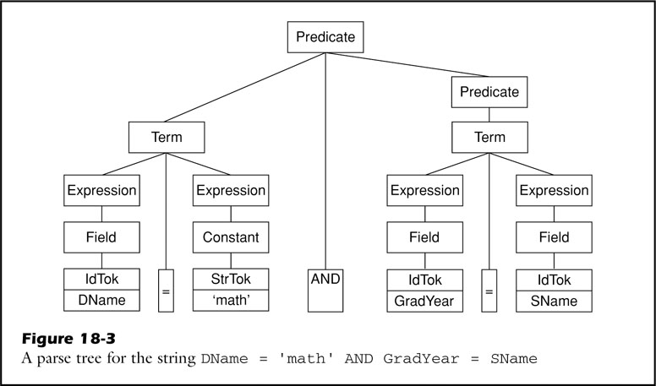
Grammars (cont)
If a string belongs to syntactic category, we can draw Parse Tree
[ Internal Node : Syntactic Category, Leaf Node : tokens ]
Input String : Dname = ‘math’ AND GradYear = SName

Slide 23
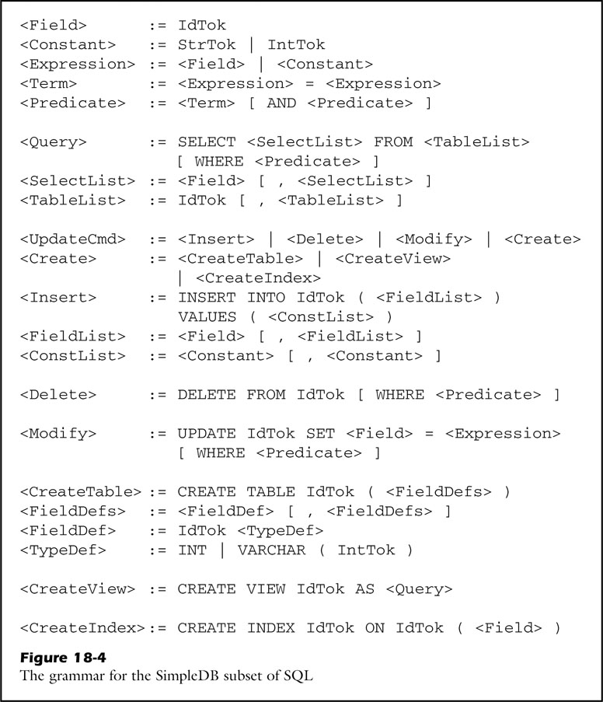
Grammars (cont)

Slide 24
Contents
18.1 Syntax vs Semantics
18.2 Lexical Analysis
18.3 Implementing the Lexical Analyzer
18.4 Grammars
18.5 Recursive-Descent Parsers
18.6 Adding Actions to the Parser

Slide 25
18.5 Recursive-Descent Parsers
In previous section, we draw parse tree.
=> Parse tree means string is syntactically legal!!
Then, how one can determine parse tree?
How can determine if a string is syntactically legal?
-> Parsing Algorithm do this job!

Slide 26
Recursive-Descent Parsers (cont)
Parsing Algorithm’s Complexity is proportional to
Grammar Complexity.
In SimpleDB, it uses Recursive-Descent parsing algorithm.

Slide 27
Recursive-Descent Parsers (cont)
Top-Down

Slide 28
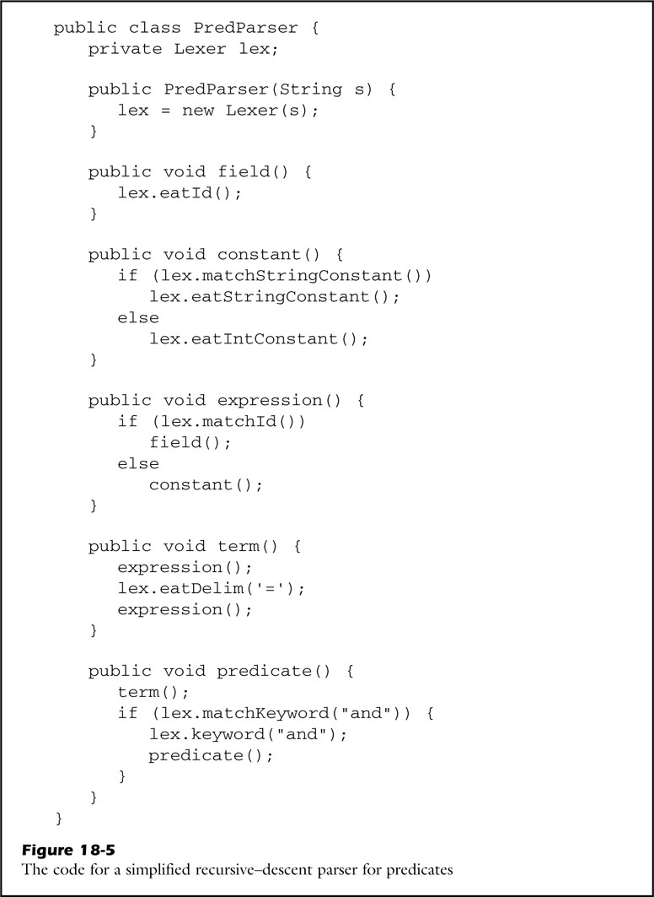
Recursive-Descent Parsers (cont)
To make SimpleDB simple, it uses Recursive Descent Algorithm
Example ) <Predicate> := <Term> [ AND <Predicate>]
Recursive-Descent (From the perspective of Parse Tree)

Slide 29
Contents
18.1 Syntax vs Semantics
18.2 Lexical Analysis
18.3 Implementing the Lexical Analyzer
18.4 Grammars
18.5 Recursive-Descent Parsers
18.6 Adding Actions to the Parser

Slide 30
18.6 Adding Actions to the Parser
Recursive-descent algorithm doesn’t do anything!
- It just see input stream and return value.
To execute SQL statement, planner needs Information.
- Modify parser to store return values.
- This is called adding Action.

Slide 31
Adding Actions to the Parser (cont)
Each type of query needs following information
- Query : SELECT fieldName FROM tableName WHERE predicate
- Insertion : INSERT INTO tableName ( fieldList ) VALUES ( constList )
- Deletion : DELETE FROM tableName WHERE predicate
- Modification : UPDATE tableName SET fieldname = Expression WHERE predicate
- Table Creation : CREATE TABLE tableName ( Field Definition )
- View Creation : CREATE VIEW viewName AS query
- Index Creation : CREATE INDEX idxName ON tableName ( fieldname )

Slide 32
Adding Actions to the Parser (cont)
This information extracts from token.
- eatIntConstant, eatStringConstant, eatId methods return values.
Appropriately store this return values.
- Class QueryData, InsertData, DeleteData, ModifyData, CreateTableData, CreateViewData, CreateIndexData.

Slide 33


Adding Actions to the Parser (cont)
Class Parser Variables, Constructor
- String s is input SQL
- Use Lexer to tokenize input SQL statement.

Slide 34
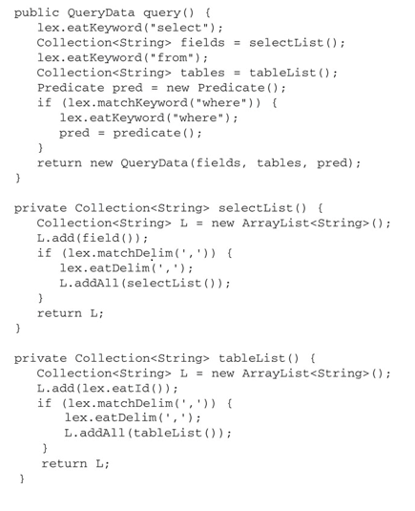
Adding Actions to the Parser (cont)
Class Parser Method (Example of Query)

Slide 35
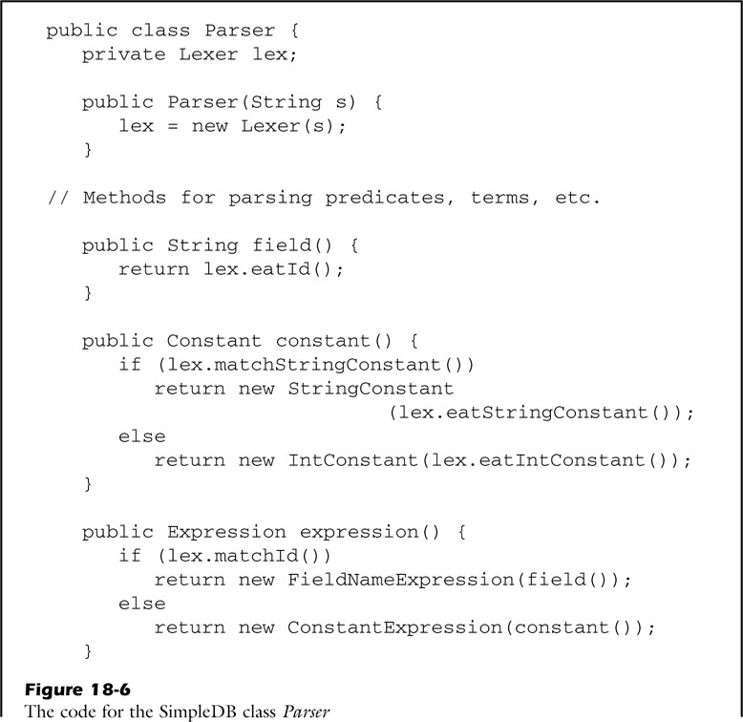
Adding Actions to the Parser (cont)
The Rest of Class Parser

Slide 36
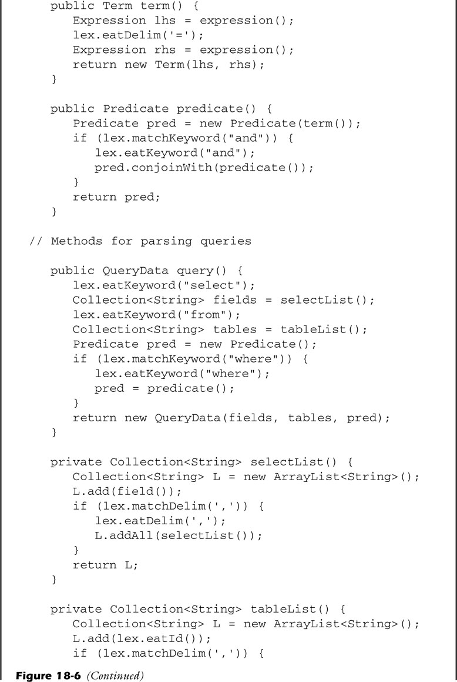
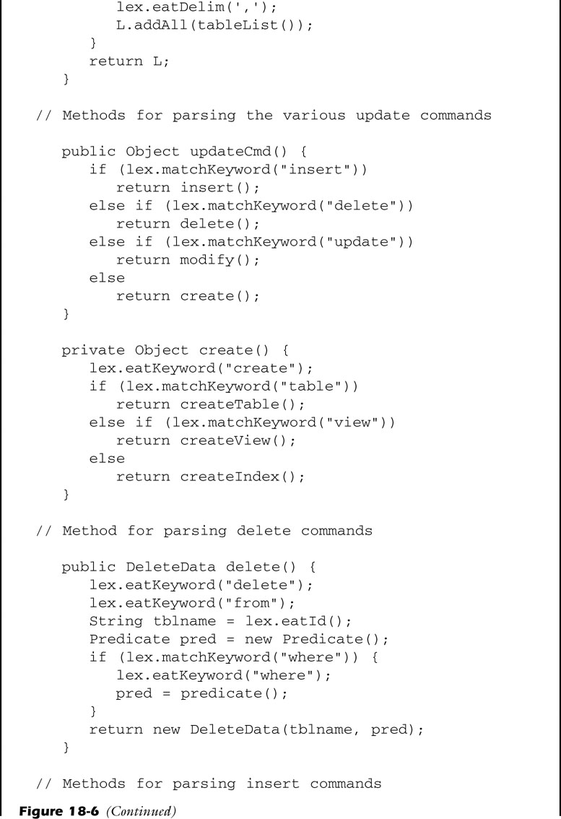
Adding Actions to the Parser (cont)

Slide 37
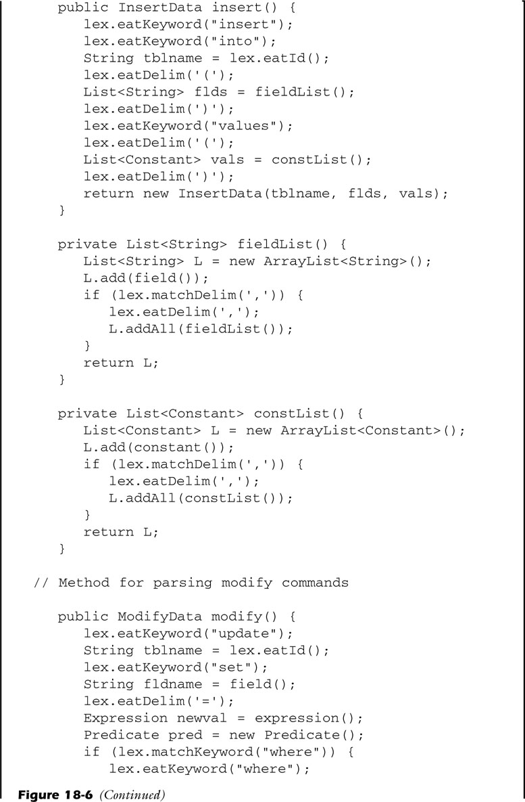
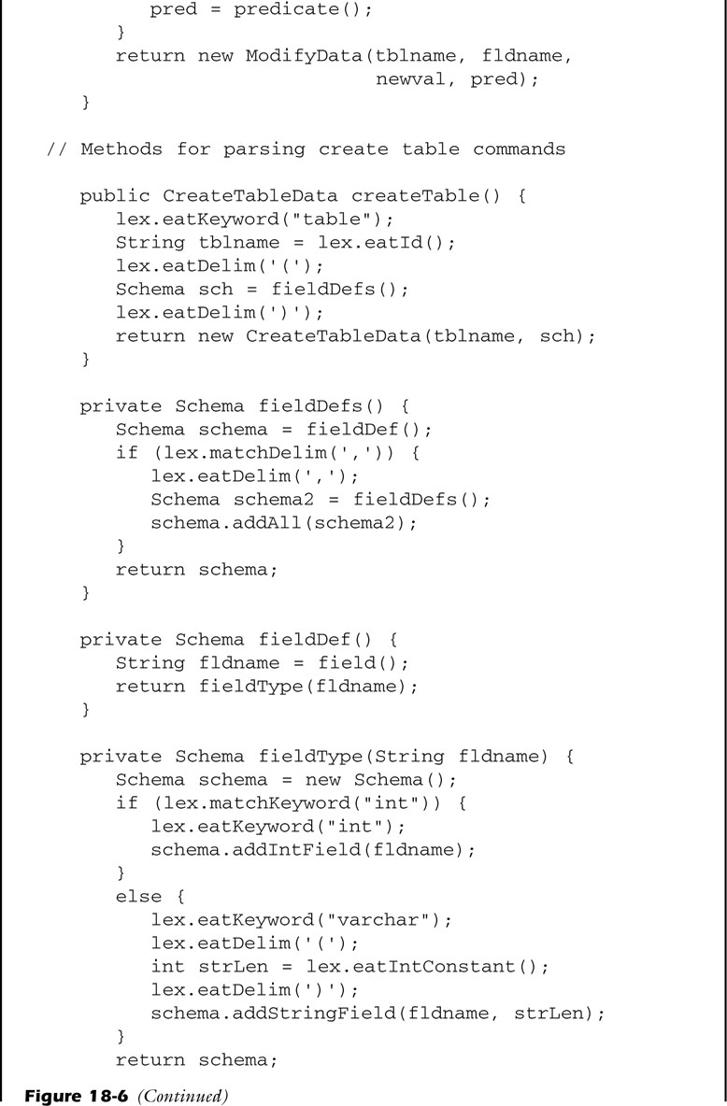
Adding Actions to the Parser (cont)

Slide 38
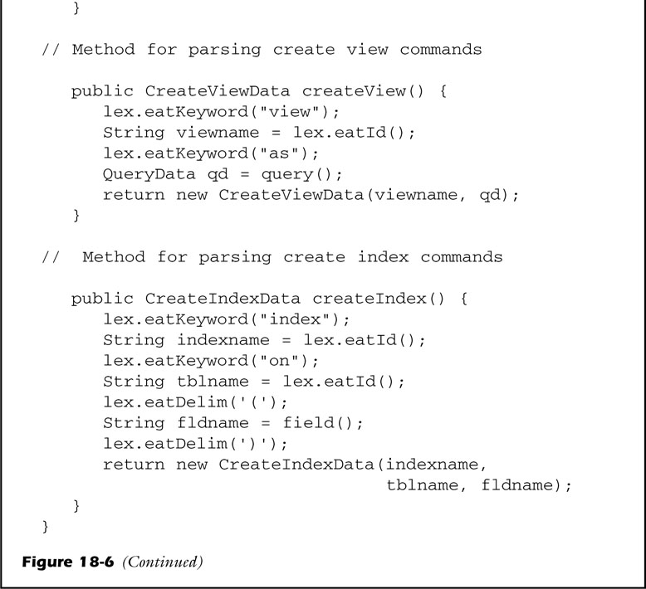
Adding Actions to the Parser (cont)

Slide 39
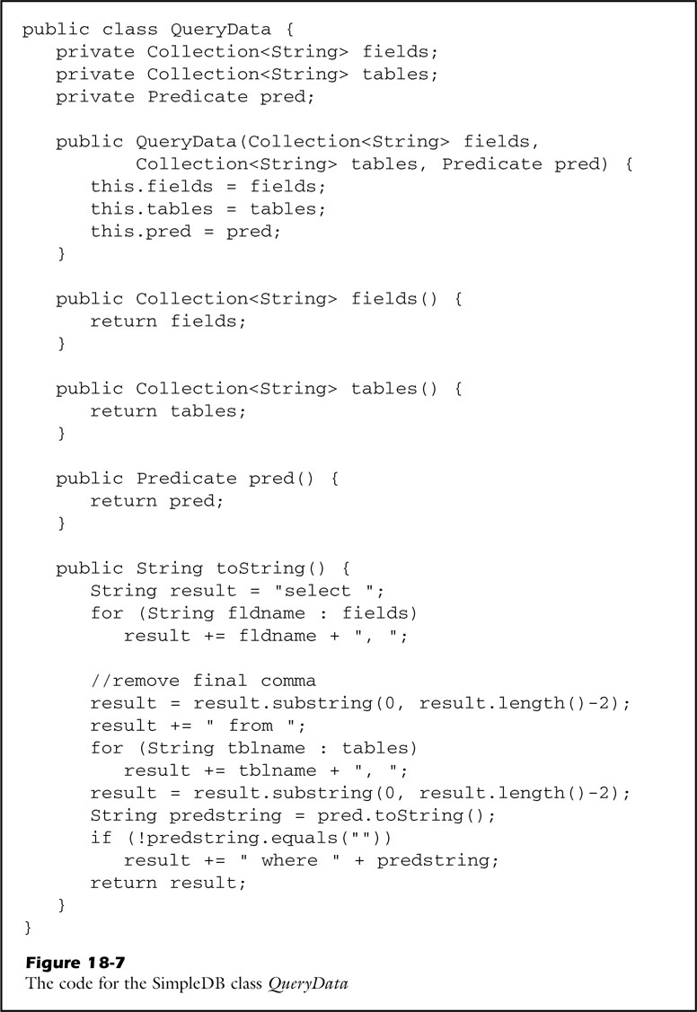
Adding Actions to the Parser (cont)
Query Data Type

Slide 40
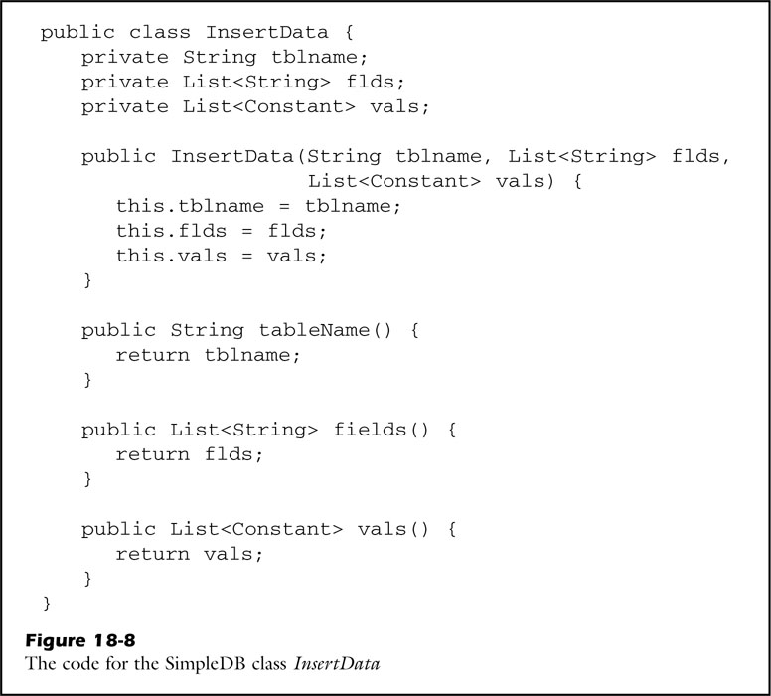
Adding Actions to the Parser (cont)
Insert Query Data Type

Slide 41
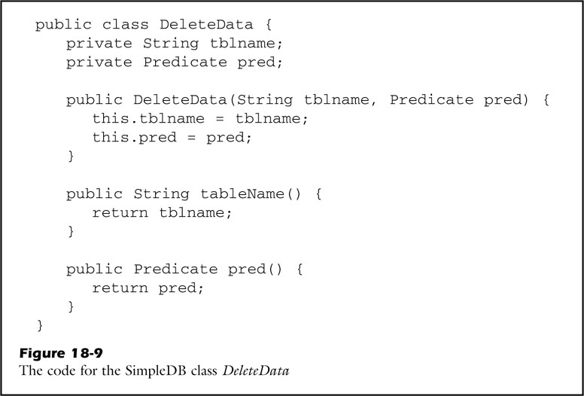
Adding Actions to the Parser (cont)
Delete Query Data Type

Slide 42
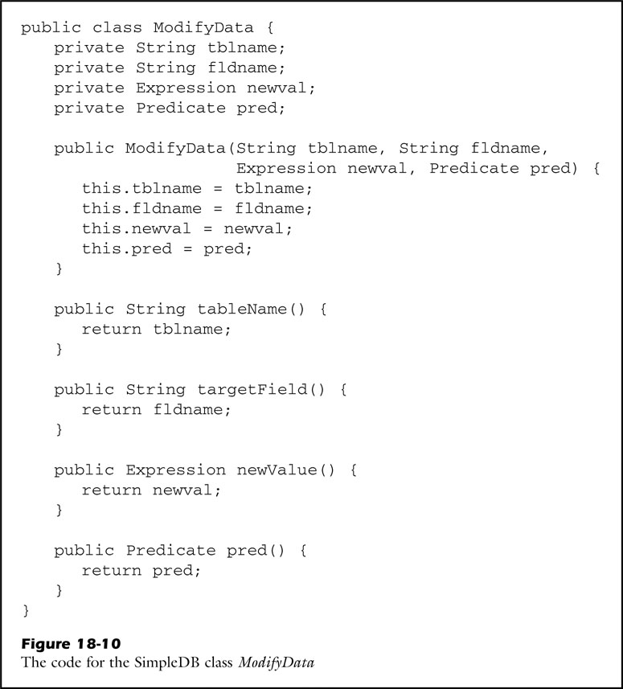
Adding Actions to the Parser (cont)
Update Query Data Type

Slide 43
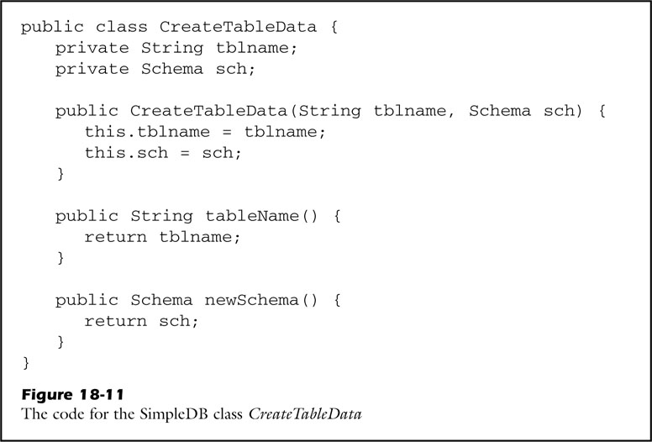
Adding Actions to the Parser (cont)
Create Table Query Data Type

Slide 44
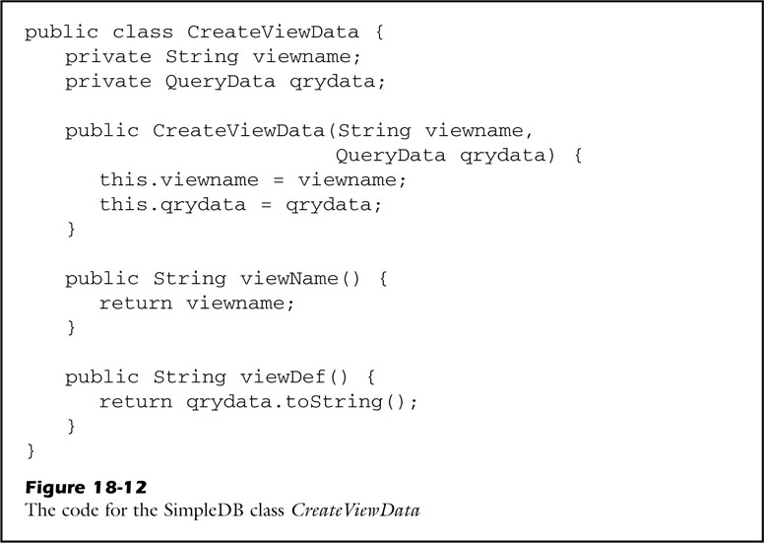
Adding Actions to the Parser (cont)
Create View Query Data Type

Slide 45
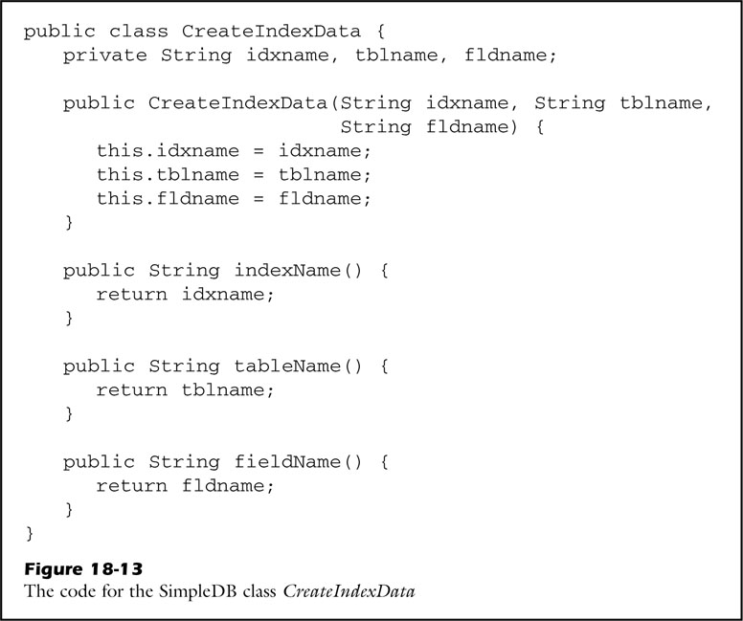
Adding Actions to the Parser (cont)
Create Index Query Data Type

Slide 46


